Slide 1
Network Topology

Slide 2
Network topology
Network topology is the layout pattern of interconnections of the various elements (links, nodes, etc.) of a computer network.
Or The way each node is physically connected to the network.
Network topologies may be physical or logical.
Physical topology means the physical design of a network including the devices, location and cable installation.
Logical topology refers to how data is actually transferred in a network as opposed to its physical design.

Slide 3
Network topology
Topology can be considered as a virtual shape or structure of a network.
This shape does not correspond to the actual physical design of the devices on the computer network.
The computers on a home network can be arranged in a circle but it does not necessarily mean that it represents a ring topology.

Slide 4
Network topology
Distances between nodes, physical interconnections, transmission rates, and/or signal types may differ in two networks and yet their topologies may be identical.
The physical and logical topologies may or may not be identical in any particular network.

Slide 5
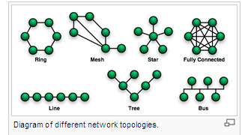
Basic topology types
The study of network topology recognizes seven basic topologies:
Point-to-point topology
Bus (point-to-multipoint) topology
Star topology
Ring topology
Tree topology
Mesh topology
Hybrid topology

Slide 6
Key Network Terminology
Node: anything connected to the network, usually a computer, but it could be a printer or a scanner
Segment: any portion of a network that is separated by a switch, bridge or a router from another part of a network.
Backbone: the main cabling of a network that all of the segment connect to. Usually, the backbone is capable of carrying more information than the individual segments.
Notes:
Backbone example: E.g. each segment may have a transfer rate of 10Mbps (megabits per second or 1 million bits a second) while the backbone may operate at 100Mbps

Slide 7
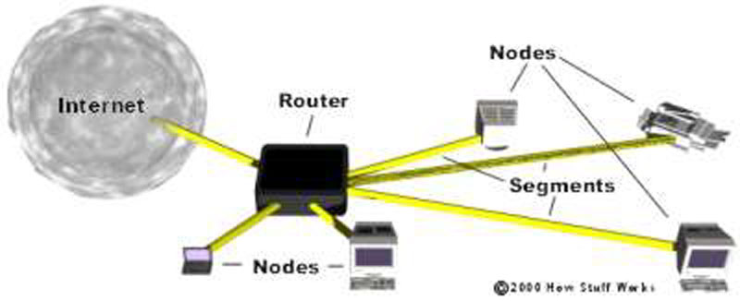
What do you see here for a typical network?
Notes:
Network - A group of computers connected together in a way that allows information to be exchanged between the computers.
Node - Anything that is connected to the network. While a node is typically a computer, it can also be something like a printer or CD-ROM tower.
Segment - Any portion of a network that is separated, by a switch, bridge or router, from other parts of the network.
Backbone - The main cabling of a network that all of the segments connect to. Typically, the backbone is capable of carrying more information than the individual segments. For example, each segment may have a transfer rate of 10 Mbps (megabits per second: 1 million bits a second), while the backbone may operate at 100 Mbps.
Topology - The way that each node is physically connected to the network.

Slide 8
Point-to-point topology
A point-to-point topology connects two nodes directly together .
In point-to-point networks, if data can only flow in one direction at a time, it is operating as a half-duplex link.
If data can successfully flow across the link from each node simultaneously, it is a full-duplex link.

Slide 9
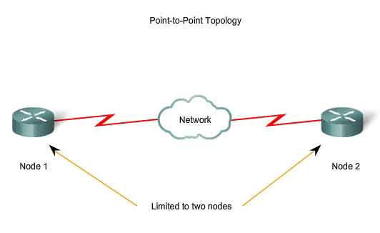
Point-to-point topology

Slide 10
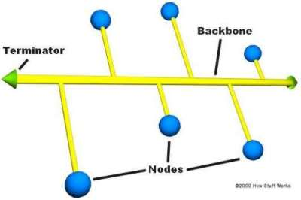
Bus Topology
A bus network topology is a network architecture in which a set of clients are connected via a shared communications line, called a bus.
A single cable, the backbone functions as a shared communication medium that devices attach or tap into with an interface connector.
A device wanting to communicate with another device on the network sends a broadcast message onto the wire that all other devices see, but only the intended recipient actually accepts and processes the message.

Slide 11
Bus Topology
Ethernet bus topologies are relatively easy to install and don't require much cabling compared to the alternatives.
10Base-2 ("ThinNet") and 10Base-5 ("ThickNet") both were popular Ethernet cabling options many years ago for bus topologies.
However, bus networks work best with a limited number of devices.
If more than a few dozen computers are added to a network bus, performance problems will likely result.
In addition, if the backbone cable fails, the entire network effectively becomes unusable.

Slide 12
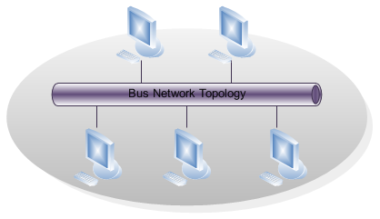
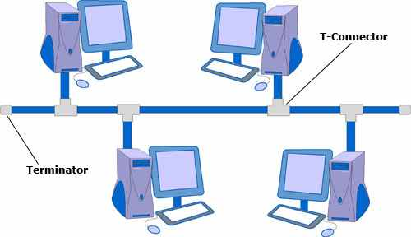
Bus topology

Slide 13
Advantages
Easy to implement and extend.
Easy to install.
Well-suited for temporary or small networks not requiring high speeds (quick setup), resulting in faster networks.
Cheaper than other topologies (But in recent years has became less important due to devices like a switch)
Cost effective; only a single cable is used.
Easy identification of cable faults.
Reduced weight due to fewer wires.

Slide 14
Disadvantages
Limited cable length and number of stations.
If there is a problem with the cable, the entire network breaks down.
Maintenance costs may be higher in the long run.
Performance degrades as additional computers are added or on heavy traffic (shared bandwidth).
Proper termination is required (loop must be in closed path).
Significant Capacitive Load (each bus transaction must be able to stretch to most distant link).
It works best with limited number of nodes.
Commonly has a slower data transfer rate than other topologies.
Only one packet can remain on the bus during one clock pulse.

Slide 15
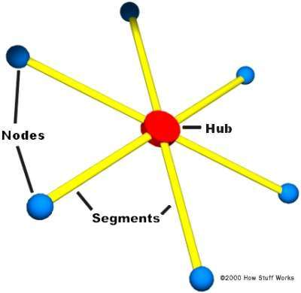
Star topology
In its simplest form, a star network consists of one central switch, hub or router, which acts as a conduit to transmit messages.
Star networks are one of the most common computer network topologies
Many home networks use the star topology.
Devices typically connect to the hub with Unshielded Twisted Pair (UTP) Ethernet.

Slide 16
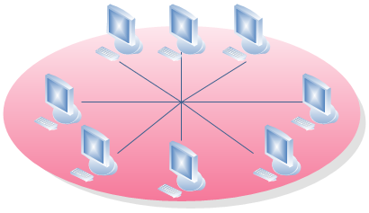
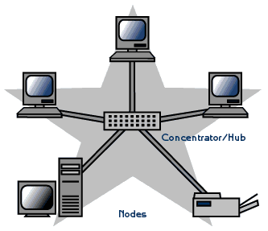
Star Topology

Slide 17
Advantages
Better performance
Isolation of devices
Benefits from centralization
Simplicity
Easy to install and wire.
Easy to detect faults and to remove parts.
No disruptions to the network when connecting or removing devices.

Slide 18
Disadvantages
High dependence of the system on the functioning of the central hub
Failure of the central hub renders the network inoperable
The performance and scalability of the network depends on the capabilities of the hub
Network size is limited by the number of connections that can be made to the hub
Other nodes may see a performance drop if traffic to another node occupies a significant portion of the central node's processing capability or throughput.
Wiring up of the system can be very expensive.

Slide 19
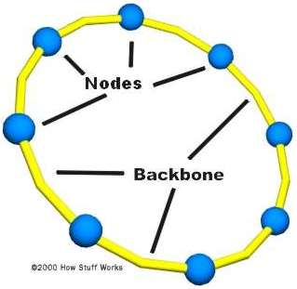
Ring Topology
A ring network is a network topology in which each node connects to exactly two other nodes, forming a single continuous pathway for signals through each node - a ring.
Data travels from node to node, with each node along the way handling every packet.

Slide 20
Advantages
Very orderly network where every device has access to the token and the opportunity to transmit
Performs better than a bus topology under heavy network load
Does not require network server to manage the connectivity between the computers

Slide 21
Disadvantages
One malfunctioning workstation or bad port in the MAU can create problems for the entire network
Moves, adds and changes of devices can affect the network
Network adapter cards and MAU's (Multistation Access Unit ) are much more expensive than Ethernet cards and hubs
Much slower than an Ethernet network under normal load

Slide 22
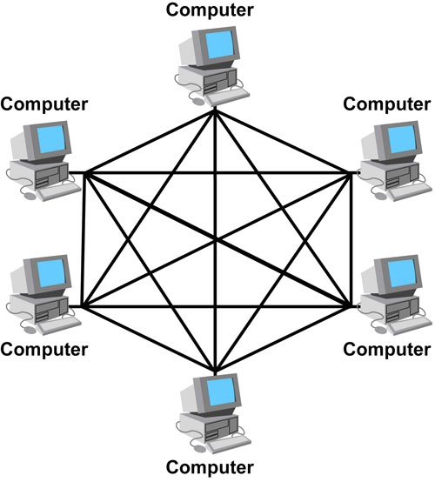
Mesh Topology
In this topology, every node has a dedicated point-to-point connection to every other node on the network. A fully connected mesh network has n(n-1)/2 channels to link ‘n’ devices.
Therefore, every device on the network must have ‘n-1′ input/output (I/O) ports.

Slide 23
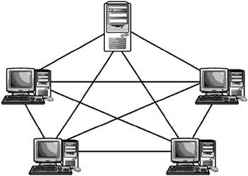
Mesh Topology
In mesh network, each node is directly connected to all nodes on the network. This type of network involves the concept of routes. In this type of network, each node may send message to destination through multiple paths.
It means that each node of mesh network has several possible paths to send (or to receive) message, but in Bus, Star, Ring and Tree topologies each node has only one path.

Slide 24
Mesh Topology
Advantages Mesh topology has the following advantages:
It has multiple links, so if one route is blocked then other routes can be used for data communication.
Each connection can have its own data load, so the traffic problem is eliminated.
It ensures the data privacy or security, because every message travels along a dedicated link.
Troubleshooting of this topology is easy as compared to other networks.
Its performance is not affected with heavy load of data transmission.

Slide 25
Mesh Topology
Disadvantages Mesh topology has the following disadvantages:
It becomes very expensive because a large number of cabling and ‘n-1′ input/output (I/O) ports for n devices are required .
It is difficult to install.

Slide 26
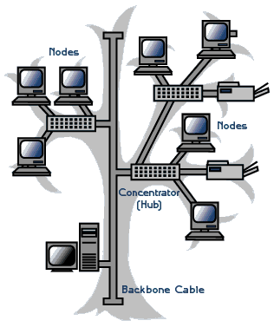
Tree Topology
In tree network, the nodes are connected to each other in such a way that forms a tree like structure.
Typically to form a tree network, multiple star topologies are combined together.
This type of network has combined features of bus and star topology.

Slide 27
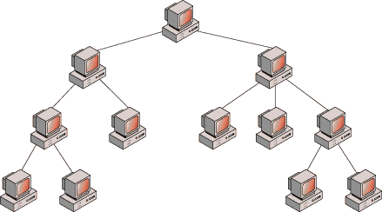
Tree Topology

Slide 28
Advantages
Point-to-point wiring for individual segments.
Supported by several hardware and software venders.

Slide 29
Disadvantage
Overall length of each segment is limited by the type of cabling used.
If the backbone line breaks, the entire segment goes down.
More difficult to configure and wire than other topologies.

Slide 30
Hybrid Topology
Hybrid networks use a combination of any two or more topologies in such a way that the resulting network does not exhibit one of the standard topologies (e.g., bus, star, ring, etc.).
For example, a tree network connected to a tree network is still a tree network, but two star networks connected together exhibit a hybrid network topology.
A hybrid topology is always produced when two different basic network topologies are connected. Two common examples for Hybrid network are: star ring network and star bus network

Slide 31
Hybrid Topology
A Star ring network consists of two or more star topologies connected using a multistation access unit (MAU) as a centralized hub.
A Star Bus network consists of two or more star topologies connected using a bus trunk (the bus trunk serves as the network's backbone).

Slide 32
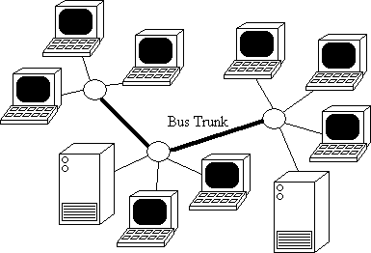
Hybrid Topology

Slide 33
Advantages
It provides a better result by it.
It can be designed in many ways for various purposes.

Slide 34
Disadvantages
It is costly.
Difficult to identify the problem if the entire network shuts down.

Slide 35
Bus Topology: Ethernet
Ethernet is a widely used technology employing a bus topology.
The original standard was published by Digital Equipment Corporation, Intel Corporation, and Xerox Corporation in 1982. IEEE currently controls Ethernet standards, e.g. IEEE 802.3 was published in 1985.

Slide 36
Bus Topology: Ethernet
In its original form, an Ethernet LAN consists of a single coaxial cable called the ether, but often referred to as a segment.
A segment is limited to 500 m in length, with a minimum separation of 3 m between each pair of connections. It operates at 10 Mbps;
a later version, Fast Ethernet, operates at 100 Mbps;
the latest version, Gigabit Ethernet, operates at 1,000 Mbps or 1 Gbps.

Slide 37
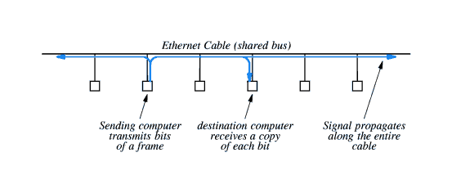
Sharing Ethernet
Ethernet requires multiple computers to share access to the ether.
A sender transmits a signal, which propagates towards both ends of the cable. This is illustrated in Figure .

Slide 38
Sharing Ethernet
The sending computer has exclusive use of the cable during the transmission of the frame.
Multiple frames cannot be sent at the same time, all other computers must wait.

Slide 39
Carrier Sense Multiple Access/Collision Detection (CSMA/CD)
All computers attached to the Ethernet use CSMA/CD to co-ordinate their activities.
A computer wishing to transmit checks for electrical activity on the cable, informally called a carrier.
If there is no carrier, the computer can transmit.
If a carrier is present, the computer waits for the sender to finish before proceeding.

Slide 40
Cont.
However, it is possible for two or more computers to detect the lack of carrier and start transmission simultaneously.
The signals travel at approximately 70% of the speed of light and interfere with one another. This interference is called a collision.
A sending computer monitors the signal on the cable and if it differs from the signal it is sending, then a collision has occurred and the computer stops transmitting.

Slide 41
Cont.
Following a collision, a computer waits for the cable to become idle before retransmitting.
However, if the computers start transmitting as soon as the cable becomes free, another collision will occur.
Ethernet requires each computer to delay after a collision. The standard specifies a maximum delay, d, and requires each computer to choose a random delay less than d.
In this case, the computer choosing the shortest delay will transmit first.

Slide 42
Cont.
If subsequent collisions still occur, the computers double the maximum delay (2d, 4d, ...) until the range is large enough for one computer to choose a short delay and transmit without a collision.
This technique is called binary exponential backoff.

Slide 43
Ring Topology: IBM Token Ring
Most LANs that employ ring technology use an access mechanism known as token passing. A token ring operates as a single, shared medium.
When a computer wants to send data, it must wait until it obtains the token, when it is in control of the ring as illustrated in figure.

Slide 44
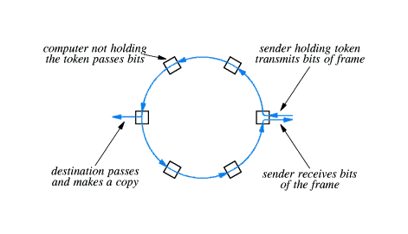
Ring Topology: IBM Token Ring

Slide 45
Ring Topology: IBM Token Ring
All stations except the sender forward bits around the ring.
The sender compares the data being received with the data being sent to ensure that no transmission errors have occurred.
The receiver makes a copy of the message as it passes the bits round the ring.

Slide 46
Ring Topology: IBM Token Ring
Co-ordination is achieved by using a special message called a token. A computer wanting to transmit must wait for the token to arrive. It removes the token from the ring and uses the ring to transmit data.
After sending one frame it retransmits the token; this token passing guarantees that stations wanting to transmit will take turns. Ensuring there is one, and only one, token on the ring is handled by the ring hardware.

Slide 47
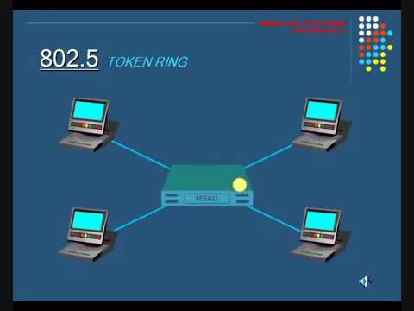
Ring Topology: IBM Token Ring

Slide 48
ATM
Asynchronous transfer mode (ATM)
Is a telecommunications concept defined by ANSI for carriage of a complete range of user traffic, including voice, data, and video signals".
It is asynchronous because cells are not transferred periodically. Cells are given time slots on demand.

Slide 49
ATM
Advantage
-Fixed packet length
-it use point to point method so transmission rate is high.
-it can transmit voice, video and graphics.
Disadvantage
-ATM costs you at least an additional 10% over a non-ATM network, just in bandwidth costs.

Slide 50
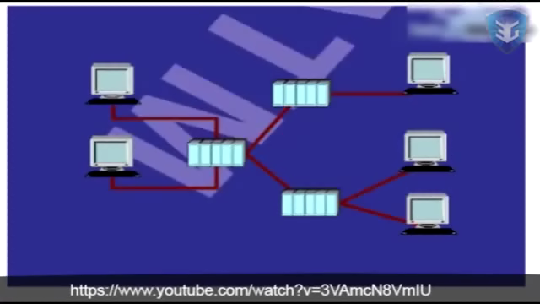
ATM

Slide 51
If you win, you need not have to explain...If you lose, you should not be there to explain!
---A.H

